Slide 1
INTRODUCTION TO COMPUTING
Course Code: CCINCOM/L
Solving for Recurrences
(Master Theorem)
Joseph Marvin R. Imperial
Faculty
Department of Computer Science
College of Computing and Information Technologies (CCIT)
National University
Joseph Marvin R. Imperial
ALGORITHMS AND COMPLEXITY
NU College of Computing and Information Technologies
Course Code: ALGOCOM

Slide 2
Recursion
A phenomenon that occurs when a thing is defined in terms of itself or of its type.
Methods exhibit recursive behavior when they can be defined by two properties:
A simple base case (or cases)—a terminating scenario that does not use recursion to produce an answer
A set of rules that reduce all other cases toward the base case
ALGORITHMS AND COMPLEXITY
Course Code: ALGOCOM

Slide 3
Recurrence Relations
A recurrence relation is an equation which is defined in terms of itself.
Many algorithms particularly divide and conquer algorithms have time complexities which are naturally modeled by recurrence relations.
Solving for recurrences or the closed form of recurrences can give the time complexity of divide and conquer algorithms.
Denoted as T(n)
ALGORITHMS AND COMPLEXITY
Course Code: ALGOCOM

Slide 4
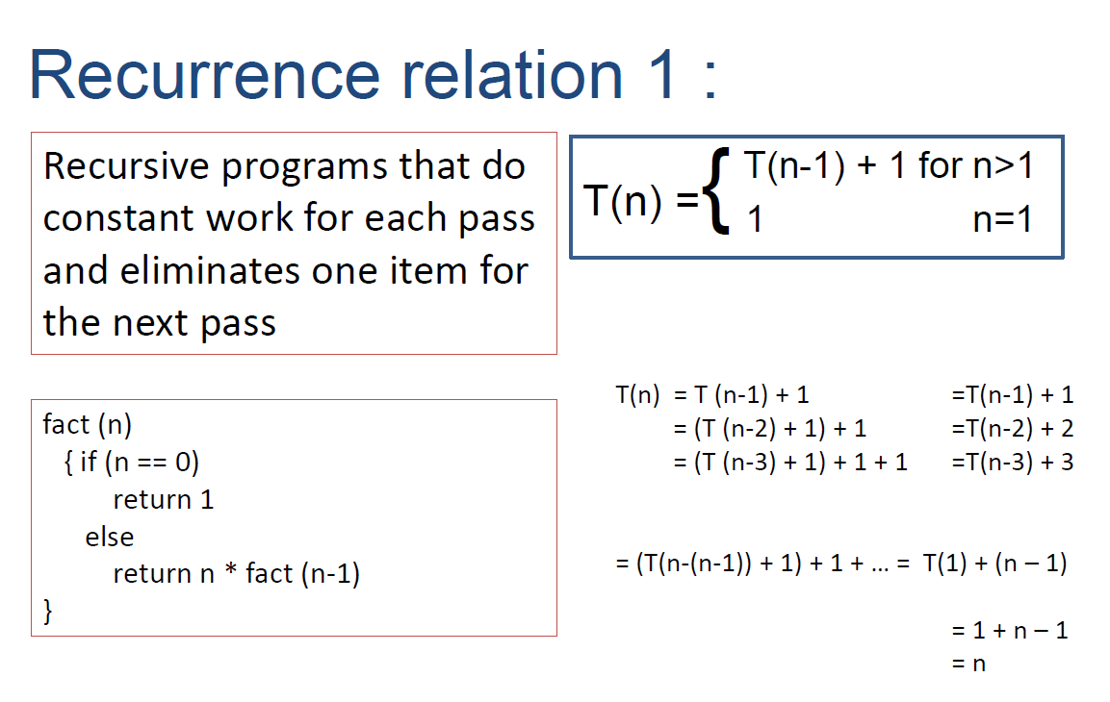
ALGORITHMS AND COMPLEXITY
Course Code: ALGOCOM

Slide 5
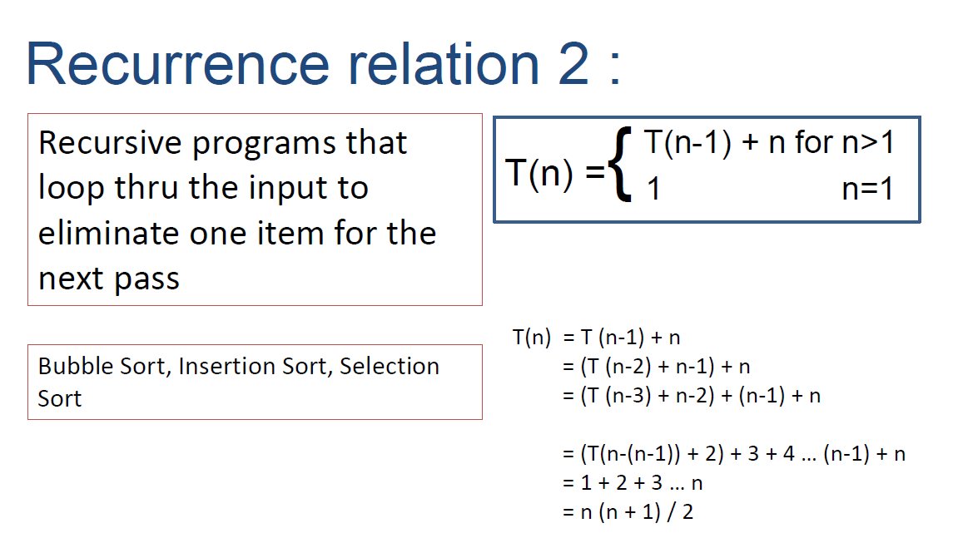
ALGORITHMS AND COMPLEXITY
Course Code: ALGOCOM

Slide 6
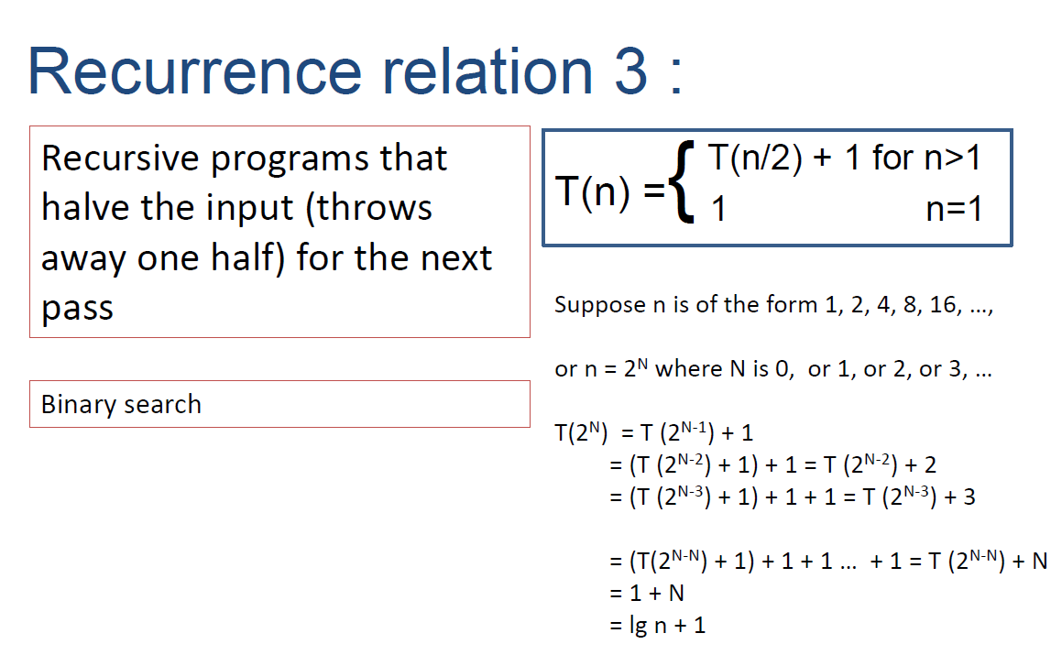
ALGORITHMS AND COMPLEXITY
Course Code: ALGOCOM

Slide 7
Master Method
The master theorem provides a solution in asymptotic terms (using Big O notation) for recurrence relations of types that occur in the analysis of many divide and conquer algorithms.
Easier than iteration but has constraints.
Described as a "unifying method" for solving such recurrences.
ALGORITHMS AND COMPLEXITY
Course Code: ALGOCOM

Slide 8
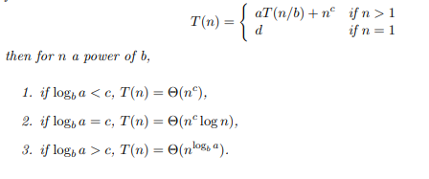
Master Method
where a ≥ 1, b > 1 are constants, and f(n) is function of non-negative integer n.
ALGORITHMS AND COMPLEXITY
Course Code: ALGOCOM

Slide 9

Cannot use Master Method if:
The recurrence function is not divide and conquer-type.
T(n) is not monotone, ex: T(n) = sin n
f(n) is exponential, ex: T(n) = 2T(n/2) + 2^{n}
b cannot be expressed as a constant, ex: T(n) = T($√$n)
ALGORITHMS AND COMPLEXITY
Course Code: ALGOCOM

